Slide 1

UNIVERSITY INSTITUTE OF ENGINEERING
COMPUTER SCIENCE ENGINEERING
Bachelor of Engineering (Computer Science & Engineering)
Subject Name: Block chain Technology
Subject Code: 20_CST-412
Structure of bitcoin
Mapped with CO3
Prepared By:
Er. Ankita Sharma
DISCOVER . LEARN . EMPOWER

Slide 2
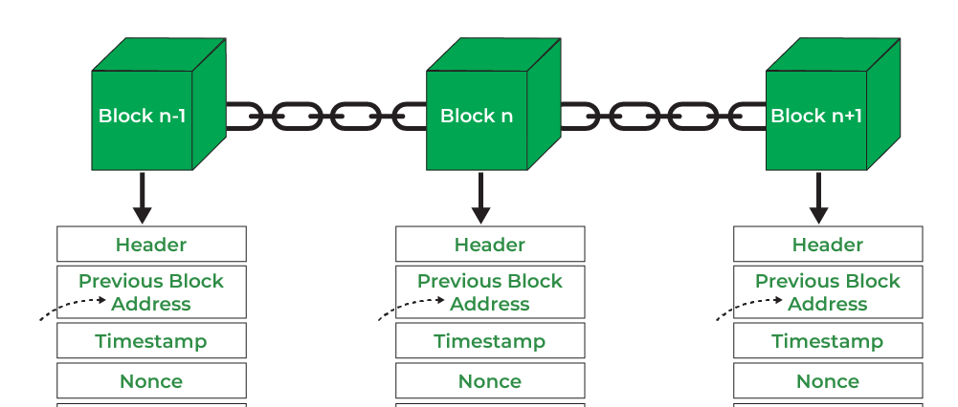
What is structure of bitcoin block chain?
A Bitcoin block records the data related to a Bitcoin transaction. The blocks are mined one after the other with all the transactions in the network being recorded permanently. Being a very secure network, the Bitcoin block chain makes it very difficult to modify or delete the data that has been registered on a block.

Slide 3
DATA
Hash Value
N O N C E
0000000ghgh4gh343g4h3g4hgghg3h4h4
Nonce(number used only once) is a number needs to be figured out such that the hash value obtained by applying
hashing function (SHA)

Slide 4
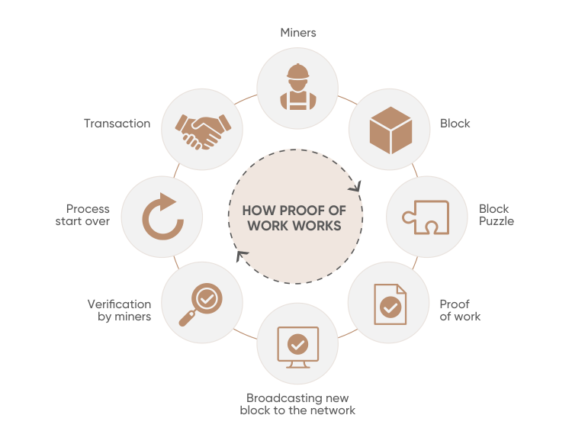
Consensus Mechanisms
Proof of work
With proof-of-work cryptocurrencies, each block of transactions has a specific hash. For the block to be confirmed, a crypto miner must generate a target hash that's less than or equal to that of the block.

Slide 5
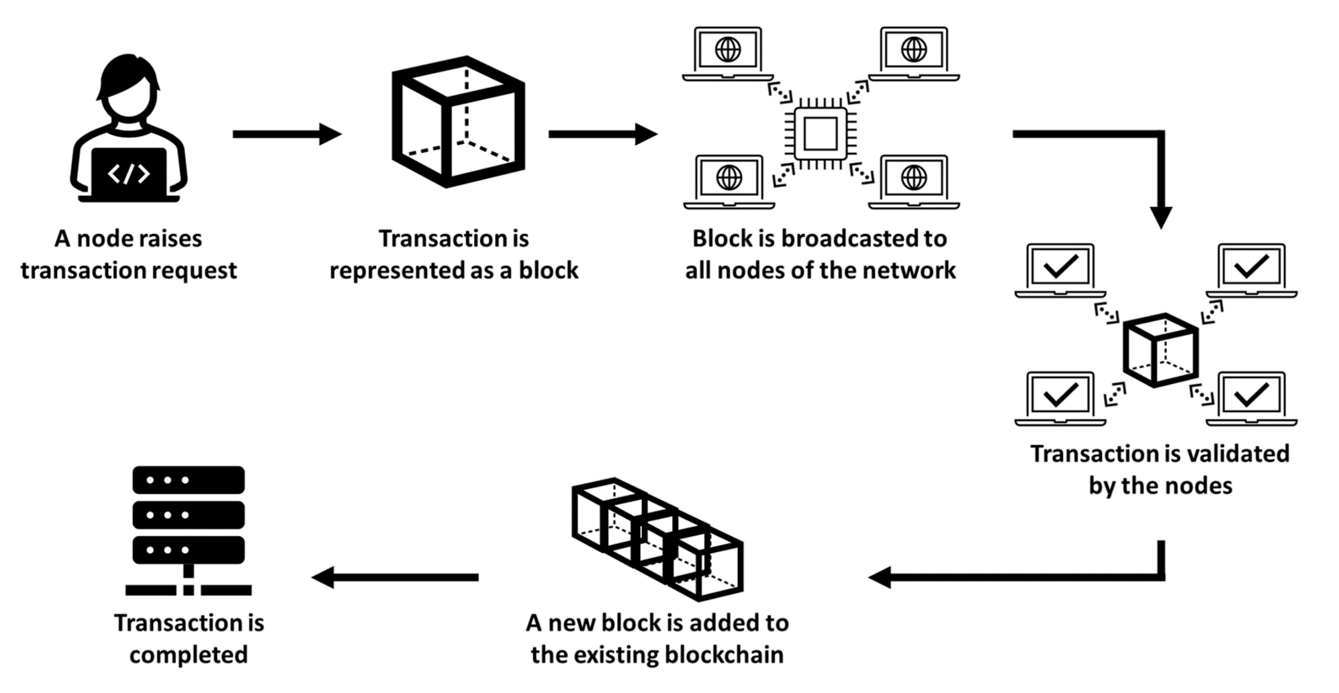
Role of a miner

Slide 6
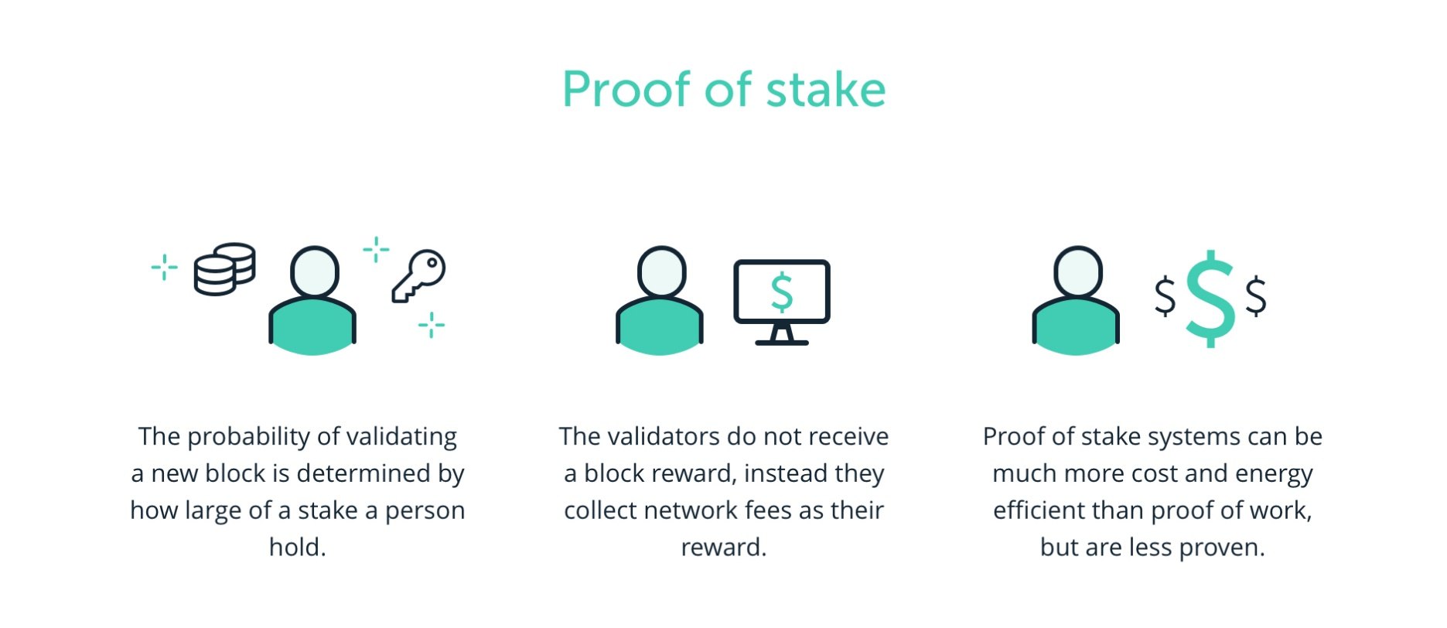
Proof of stake
In this type of consensus algorithm, instead of investing in expensive
hardware to solve a complex puzzle, validators invest in the coins of the system by locking up some of their coins as stake.

Slide 7
Difference Between Proof of work and proof of stake
S.No. | Proof of Work (PoW) | Proof of Stake (PoS)
1. | The probability of mining a block is determined by how much computational work is done by miner. | The probability of validating a new block is determined by how large of a stake a person holds (how many coins they possess).
2. | A reward is given to first miner to solve cryptographic puzzle of each block. | The validator donot receive a block reward instead they collect network fee as their reward.
3. | To add each block to chain, miners must compete to solve difficult puzzles using their computer process power | There is no competition as block creator is .chosen by an algorithm based on user stake.

Slide 8
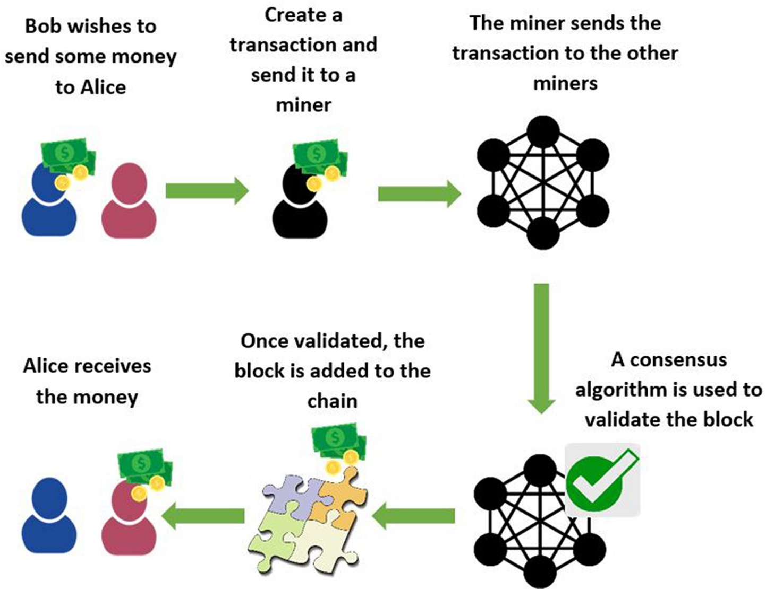
Working of Bit coin
Transactions
Verification
Block Formation
Mining
Consensus
Decentralization

